Slide 1
Unlearning the GIL
in Free-threaded Python
Rethinking Python concurrency through a Rust lens
Xavier Yen (顏志穎) · PyCon TW 2026 · Day 1, R0, 14:00
github.com/xavierforge/red_envelope_demo (tag pycon-tw-2026-r2)

Slide 2

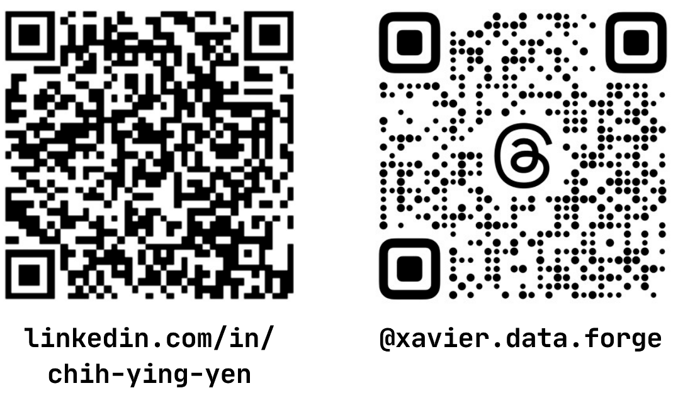
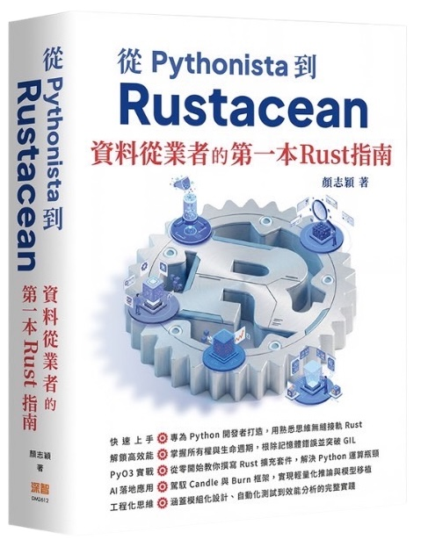
About me
Author of “From Pythonista to Rustacean” (深智數位, 2026)
Contributor to PyO3, cuda-oxide, and HuggingFace Candle;
co-maintainer of zerostack
Data engineer at a multinational telecom equipment vendor
xavierforge.dev

Slide 3
Does this survive without the GIL?
Python
cache: dict[int, int] = {}
def get(key: int) -> int:
?
if key not in cache: # check
cache[key] = compute(key) # act (with a CALL in between)
return cache[key]
Requirement: each key is computed at most once
(compute is expensive, or has side effects).

Slide 4
It was never safe. The GIL just made it rare.
GIL on (default 5 ms)
GIL off
10–11
183–276
duplicates out of 512 lookups (~2%)
duplicates out of 512 lookups (36–54%)
The dict stayed intact. Our logic did not.
Source: results/cache_probe_2026-10-11.txt · 64 keys, 8 threads, compute ≈ 1 ms, 5 runs per cell

Slide 5

Why now: pure-Python threads finally run in parallel
Workload | GIL on | GIL off | Speedup
Pure-Python arithmetic (1 thread) | 18.9 s | 19.1 s | baseline
Pure-Python arithmetic (8 threads) | 19.1 s (0.99x) | 3.8 s (5.01x) | ≈ 5.0x
Same
free-threaded
build
(Python
3.14.6t),
switched
with
.
-X gil=1/0
3.13
3.14
3.15 (Oct 9, 2026)
experimental
officially supported
macOS installer ships
python3.15t
by default
Source: results/compare_2026-10-11.txt

Slide 6
Free-threaded builds open the door to parallelism,
but they don't protect you once you walk through it.

Slide 7
The Agenda
Act I
Act II
Act III
The GIL
Blind Spot
The Rust
Mindset
The Free-threaded
Future
Prerequisites: GIL & free-threading basics (no Rust background needed).

Slide 8
Act I · The GIL Blind Spot
Who else holds this?
Is anyone changing it?
The GIL let us ignore these two questions.
Rust turns them into compile-time checks.

Slide 9
Everyone writes this
Python
class Counter:
def __init__(self) -> None:
self.value = 0
def run_a(self, n: int) -> None:
for _ in range(n):
self.value += 1
# 8 threads × 200,000 = 1,600,000
Who else holds
self.value
? 8 threads.
Is anyone changing it? All 8.
Out of 1,600,000 updates, how many get lost?

Slide 10
Zero.
GIL on, 5 ms
GIL on, 1 µs
GIL off
0
0
78–83%
lost (5/5)
lost (5/5)
lost
Python 3.14.6t (switched via
-X gil=1/0
), 5 runs per setting
So the GIL protects it?
Source: results/switchpoint_probe_2026-10-11.txt

Slide 11
Same logic, slightly different shape
Python
def step() -> int:
return 1
# Counter.run_b
self.value = self.value + step()
GIL on, 5 ms
GIL on, 1 µs
GIL off
0–58%
65–68%
80–81%
lost (3 of 5 runs)
lost
lost
Source: results/switchpoint_probe_2026-10-11.txt

Slide 12
Where the GIL can switch
Python · self.value += 1
Python · self.value = self.value + step()
LOAD_FAST_BORROW self
LOAD_FAST_BORROW self
COPY 1
LOAD_ATTR value
LOAD_ATTR value
LOAD_GLOBAL step
LOAD_SMALL_INT 1
CALL 0 ← between load and store
BINARY_OP +=
BINARY_OP +
SWAP 2
LOAD_FAST_BORROW self
STORE_ATTR value
STORE_ATTR value
JUMP_BACKWARD → loop ← after the store
JUMP_BACKWARD → loop
Since 3.10 (bpo-29988), periodic GIL checks run at backward jumps, function calls, and RESUME. Other hand-off points exist.
Safety depended on code shape, not logic.
The everyday version got lucky, so we stopped checking.

Slide 13
Reason 1: asking didn't help
“I asked. Nothing happened.”
asking didn't help
the dict never broke
it rarely happened
the docs said so

Slide 14

Reason 2: built-in containers never broke
Python
What kinds of global value mutation are thread-safe?
cache: dict[int, int] = {}
L.append(x)
L1.extend(L2)
def get(key: int) -> int:
D[x] = y
if key not in cache:
D1.update(D2)
cache[key] = compute(key)
When in doubt, use a mutex!
return cache[key]
docs.python.org/3/faq/library.html
“The dict is thread-safe, so sharing it is fine.”
One step is safe; two in a row are not. Our cache takes two.
asking didn't help
the dict never broke
it rarely happened
the docs said so

Slide 15
Reason 3: it rarely happened
Python · lazy initialization
Python · module-level cache
if _instance is None:
if key not in cache:
_instance = Expensive()
cache[key] = compute(key)
Both have a function call right between the check and the write.
“I ran it. It worked.”
A race window opens every 5 ms. Rare enough to look safe.
asking didn't help
the dict never broke
it rarely happened
the docs said so

Slide 16
...and threads were for I/O
Threads
Processes
for I/O
for CPU
sharing is free
nothing shared
low contention
messages only
The only place we shared state was the place we never stressed.
asking didn't help
the dict never broke
it rarely happened
the docs said so

Slide 17
Reason 4: the docs said so
pandas:
“pandas
is
not
100%
thread
safe.
The
known
issues
relate
to
the
copy()
method.”
pandas.pydata.org/docs/user_guide/gotchas.html
SQLAlchemy: “The Session... cannot be shared among concurrent threads or asyncio tasks without careful synchronization.”
docs.sqlalchemy.org/en/21/orm/session_basics.html
cachetools: “all these classes are not thread-safe”
cachetools.readthedocs.io
“The docs are just being cautious.”
Thread safety lives in the docs, not the code. Miss a line, and nothing warns you.
asking didn't help
the dict never broke
it rarely happened
the docs said so

Slide 18
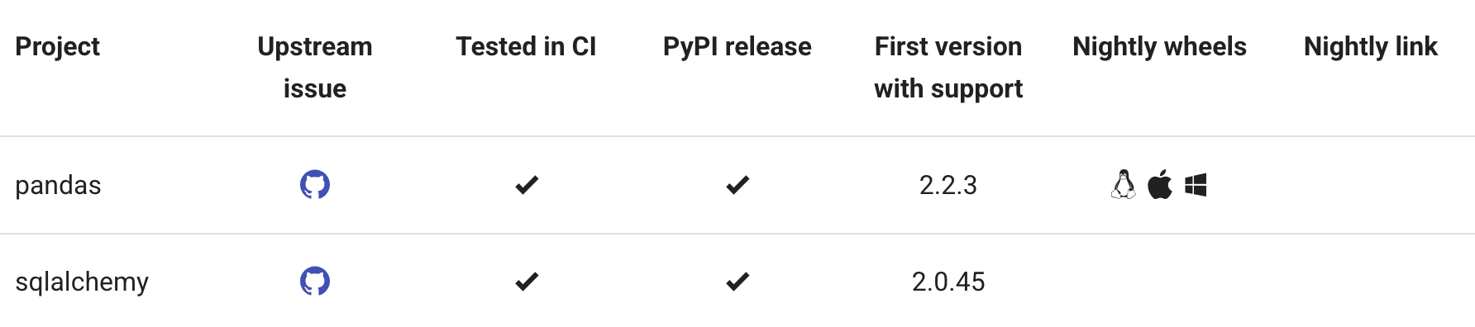
“Supports free-threading” is not “thread-safe”
pandas and SQLAlchemy are on the list. Their warnings are still in the docs.
The library did its part. Combining the calls is still on you.
Can a SQLAlchemy Session be handed to another thread? Can two threads read it at once?

Slide 19
The GIL-era blind spot
“Thread safety isn't my problem. Python handles it.”
“I asked. Nothing happened.”
“The dict is thread-safe.”
“I ran it. It worked.”
“The docs are just being cautious.”
I've said all four.
We didn't lack knowledge. We lacked a reflex: asking those two questions.

Slide 20
Why the bill comes due now
1. True parallelism. Threads now interleave constantly, not every 5 ms.
2. CPU-bound threads finally pay off.
Failure rate · cache
Failure rate · counter
36–54%
78–83%
“rare” →
“rare” →
Same code, same traps. Rare bugs just became everyday bugs.

Slide 21

Old advice, now front and center
Python 3.14 free-threading HOWTO
Python FAQ
“It's
recommended
to
use
the
threading.Lock
or
other
When in doubt, use a mutex!
synchronization
primitives
instead
of
relying
on
the
internal
locks
of
built-in
types,
when
possible.”
docs.python.org/3/howto/free-threading-python.html
Python 3.14 adds a “Thread Safety Guarantees” page, and the bottom line is still: use a Lock.

Slide 22
These bugs show up in mature code.
Mine included.
Python never required the two questions.
Rust's type system does.
Knowing isn't enough to change habits. Something has to force the question, every time.

Slide 23
Act II · The Rust Mindset
Who else holds this?
Is anyone changing it?
In Rust, these questions aren't a habit.
The type system asks them for every value, and won't compile an unsafe answer.
Next, we'll bring these questions back to Python, even without the compiler.

Slide 24
The compiler asks first
Rust
fn main() {
let mut v = vec![1, 2, 3];
let first = &v;
v.push(4);
println!("{first:?}");
}
Rust · cargo check
error[E0502]: cannot borrow `v` as mutable because it is also borrowed as immutable
--> src/main.rs:4:5
|
3 | let first = &v;
| -- immutable borrow occurs here ← someone else is holding it
4 | v.push(4);
| ^^^^^^^^^ mutable borrow occurs here ← while you try to mutate it
5 | println!("{first:?}");
| ----- immutable borrow later used here ← and it's still needed afterwards
The compiler asked both questions, without a single thread in sight.

Slide 25

Data races vs. race conditions
from Act I
“The dict stayed intact. Our logic did not.”
Memory layer (the dict's internal structure)
Data race
compiler guards this
Logic layer (our business rule)
Race condition
on you
All four traps in Act I were race conditions.
Rust guarantees memory safety. For logic bugs, there's no guarantee, only a playbook.

Slide 26
Why one tool covers both
“Over time, the team discovered that the ownership and type systems are a powerful set of tools to help manage memory safety and concurrency problems!”
“By leveraging ownership and type checking, many concurrency errors are compile-time errors in Rust rather than runtime errors.”
The Rust Book, ch. 16 · doc.rust-lang.org/book/ch16-00-concurrency.html
Ownership tracks who holds data and who mutates it. Threads just raise the stakes.

Slide 27
The rule it checks
1
Two or more threads access the same memory at the same time.
blocked by: type system
2
At least one of them is writing.
blocked by: type system
3
Nothing synchronizes the access.
blocked by: Mutex / Atomic
in Python: the interpreter
All three together = a data race.
Safe Rust makes this impossible to express: enforced by the type system + safe standard library abstractions.
Python's interpreter handles #3 for built-in types. That's why the dict never crashed.
A data race needs all three conditions. Rust makes sure they never meet.

Slide 28
Where the first answer lives
Three symbols you'll keep seeing: owner,
&
,
&mut
owner
every value has exactly one owner.
&T
(shared borrow): others may hold it too; read-only.
&mut T
(exclusive borrow): nobody else holds it;
safe to mutate.
Rust
Python
Many
&
OR one
&mut
, never both.
Who holds it?
owner · & · &mut
(Aliasing XOR Mutability)
Is it mutated?
Across threads
Every
&
or
&mut
answers
the
first
question
right
in
the
code.

Slide 29
Where the second answer lives
Immutable by default.
To mutate directly, you must declare it:
mut
or
&mut
.
To
mutate
through
a
shared
&
reference,
wrap
it
in
a
synchronized
container:
Mutex<T>
,
AtomicU64
.
The container itself declares: every write goes through synchronization, eliminating condition #3.
Rust
Python
Who holds it?
owner · & · &mut
Is it mutated?
mut · &mut ·
Mutex / Atomic
Across threads
Every mutation must be explicitly declared, or synchronized.

Slide 30
Python has nowhere to express these answers
Python
a = Account()
b = a; c = a # any reference can change it
b.balance -= 1 # no owner, no &, no &mut
from Act I
“Thread safety lives in the docs, not the code.”
Yet the runtime answers both questions for its own objects:
• Who holds it? → Reference counting, biased RC
• Who mutates it? → Per-object locks, critical sections
• Built for speed: optimistic lock-free reads
(3.14t: ~5–10% single-thread overhead)
Rust
Python
Who holds it?
owner · & · &mut
Is it mutated?
mut · &mut ·
Mutex / Atomic
Across threads
Python's syntax doesn't ask these questions. The runtime protects its own memory, not your logic.

Slide 31
Send: asked when you move it
When you move a value to another thread, the compiler asks Question 1 again: does anyone else still hold it?
Python mirror
jobs = queue.Queue() # thread-safe hand-off
Send: ownership transfers cleanly (most types).
# producer thread
jobs.put(job) # mental Send: hands off
!Send: leaves a hidden string attached: Rc (unsynchronized counter), MutexGuard (tied to the locking thread).
# ...and never touch job again
# worker thread
Arc<T>
:
uses
an
atomic
counter,
so
it's
Send
(as
long
as
T
itself
is
job = jobs.get() # now it's theirs
Send
+
Sync).
Rust
Python
Who holds it?
owner · & · &mut
Is it mutated?
mut · &mut ·
Mutex / Atomic
Across threads
Send
Moving data across threads triggers the first question all over again.

Slide 32
Sync: asked when you share it
When
multiple
threads
share
a
&
reference,
the
compiler
asks
Python mirror
Question
2
again:
can
anyone
secretly
write
to
it?
@dataclass(frozen=True)
class Config: # nothing writes
Interior
mutability:
a
method
takes
&self
,
yet
mutates
internal
rate: int
state.
class SafeCounter:
def __init__(self):
Synchronized (Mutex, Atomic) → Sync. Unsynchronized (Rc's counter) → !Sync. (Rc fails both gates for the exact same reason.)
self._lock = threading.Lock()
self._value = 0
def increment(self):
By definition: T is Sync if and only if
&T
is Send.
with self._lock: # synchronized
self._value += 1
Rust
Python
Who holds it?
owner · & · &mut
Is it mutated?
mut · &mut ·
Mutex / Atomic
Across threads
Send · Sync
Cross a thread boundary, and the compiler asks both questions again.

Slide 33
What the compiler covers, and what it leaves out
from Act I
“Thread safety isn't my problem. Python handles it.”
Covers
Leaves out
“Fearless concurrency” means one specific thing: safe Rust cannot express a data race.
The compiler does not prevent race conditions or deadlocks. (The Rustonomicon)
Python's
runtime,
in
Rust
terms:
every
object
is
wrapped
like
an
Arc<T>
,
and
built-in
containers
synchronize
their
own
internal
structure.
The
runtime
answers
both
questions
for
its
own
memory,
not
for
your
business
logic.
Rust
Python
Who holds it?
owner · & · &mut
Is it mutated?
mut · &mut ·
Mutex / Atomic
Across threads
Send · Sync
Python's runtime already protects memory. From Rust, we borrow how to make correct logic the default.

Slide 34
Idiomatic Rust
Rust
use std::sync::{Mutex, MutexGuard};
fn withdraw(account: &Mutex<u64>, amount: u64) {
let mut balance: MutexGuard<u64> = account.lock().unwrap();
if *balance >= amount {
*balance -= amount;
}
} // guard dropped here, lock released
fn main() {
let account: Mutex<u64> = Mutex::new(100);
withdraw(&account, 30);
}
Idiomatic Rust: correct by default. The guard is the only way to the data.

Slide 35
Racy Rust
Rust
use std::sync::Mutex;
fn withdraw(account: &Mutex<u64>, amount: u64) {
let ok = *account.lock().unwrap() >= amount;
if ok {
*account.lock().unwrap() -= amount;
}
}
fn main() {
let account: Mutex<u64> = Mutex::new(100);
withdraw(&account, 30);
}
Racy Rust: compiles, but the double
lock()
stands out.
Notes:
原因是 account.lock().unwrap() 回傳的 MutexGuard<u64> 在這裡是一個 temporary，沒有綁定到任何具名變數。Rust 對 temporary 的規則是它活到所在的那個 statement 結束，也就是分號為止。這一行真正綁定到 ok 的東西是 *guard >= amount 的結果，一個 bool，是 Copy，跟 guard 之間沒有任何借用關係，所以 temporary lifetime extension 也不會啟動（那只在 let x = &temp; 這類直接借用 temporary 的寫法才會發生）。分號一到，guard 被 drop，Drop for MutexGuard 把 lock 釋放掉。

Slide 36
Hiding the parts in Python
Plain Python
Encapsulated Python
if self.balance >= amount:
class Account:
self.balance -= amount
def __init__(self, balance: int) -> None:
The version everyone writes first.
self._lock = threading.Lock()
self._balance = balance
def withdraw(self, amount: int) -> bool:
with self._lock:
if self._balance >= amount:
self._balance -= amount
return True
return False
# no get_balance, no set_balance; need flexibility? update(fn)
408,510
withdrawn
0
overdrawn
from a balance of 100,000 · 8 threads withdrawing 1 until refused
same test, every call through
withdraw()
Plain Python: broken,
and it looks completely fine.
Encapsulated Python: the correct call is the easy one;
the racy path needs
_balance
.
Source: mental_model/04_api_shape.py · results/mental_model_outputs_2026-10-13.txt

Slide 37
Types in Rust, API design in Python
The Path of Least Resistance
The Racy Code
Rust
Idiomatic Rust: correct by default
Racy Rust: compiles, but the double
lock()
stands out
Python
Plain Python: broken, and it looks completely fine
The same code. Nothing stands out.
Encapsulated Python: the correct call is the easy one
The racy path needs
_balance
Note:
A
“
with lock() as data:
”
wrapper
in
Python
is
just
a
convention.
The
data
reference
still
outlives
the
with-block,
unlocked.
Rust uses types to make the obvious code correct. Python can use API design to do the same.

Slide 38
Don't share, freeze it, or lock the whole operation
Rust's default
In Python, by hand
1 · Don't share
Not
shared
unless
wrapped
in
queue.put()
and
let
go
Arc<Mutex<T>>
split
input,
merge
results
2 · Freeze it
tuple,
frozenset,
@dataclass(frozen=True)
Immutable
unless
declared
mut
,
frozendict
(3.15)
·
all
shallow
3 · Lock the operation
withdraw()
:
one
method,
one
lock,
no
raw
getters
The
lock
owns
the
data
or
setters
Rust makes these three the default. In Python, you choose one each time.

Slide 39
Three questions
1. Who else holds this?
2. Is anyone mutating it?
3. If both: give each thread a copy,
freeze it, or lock the whole operation?
Asking the questions won't magically erase bugs. It tells you exactly where to put the fix.
Rust
Python
Who holds it?
owner · & · &mut
a mental reflex
Is it mutated?
mut · &mut ·
Mutex / Atomic
API encapsulation
Across threads
Send · Sync
The first two questions spot the danger. The third picks the fix.

Slide 40
Reading Python docs with Send and Sync
from Act I
“Can a Session be handed to another thread?
Can two threads read it at once?”
SQLAlchemy Session → Use in one thread at a time (!Sync); moving it depends on the underlying connection.
sqlite3.connect()
→
check_same_thread=True
by
default
(a
runtime-enforced
!Send).
asyncio
event
loop
→
!Sync,
so
cross-thread
calls
must
go
through
a
channel
(
call_soon_threadsafe
).
Rust
Python
Shared iterators → !Sync
(explicitly called out in the free-threading HOWTO).
Who holds it?
owner · & · &mut
a mental reflex
Is it mutated?
mut · &mut ·
Mutex / Atomic
API encapsulation
Across threads
Send · Sync
a shared vocabulary
“Not thread-safe” is too vague. Send and Sync tell you what's actually forbidden.

Slide 41
Act III · The Free-threaded Future
Who else holds this?
Is anyone changing it?
Which of your packages actually get faster? One simple rule decides.
Then we'll see who asks the two questions, right where the speedup happens.

Slide 42
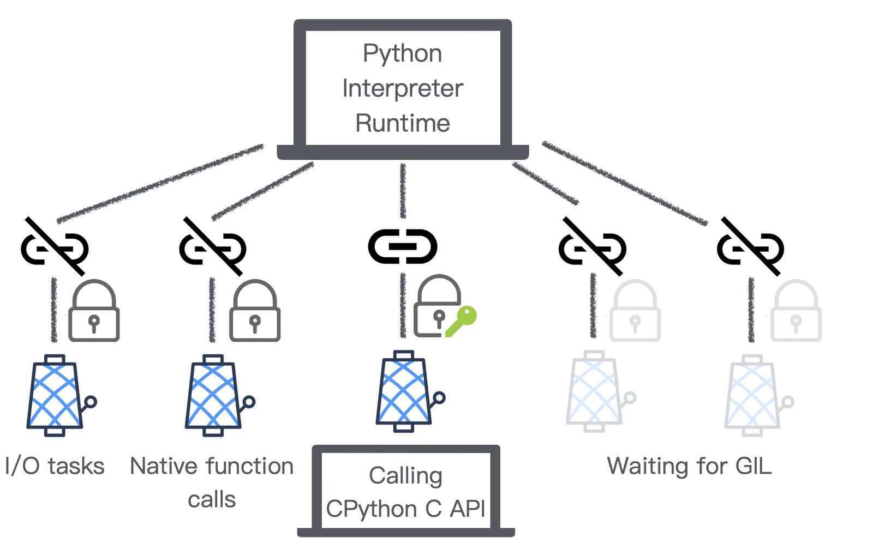
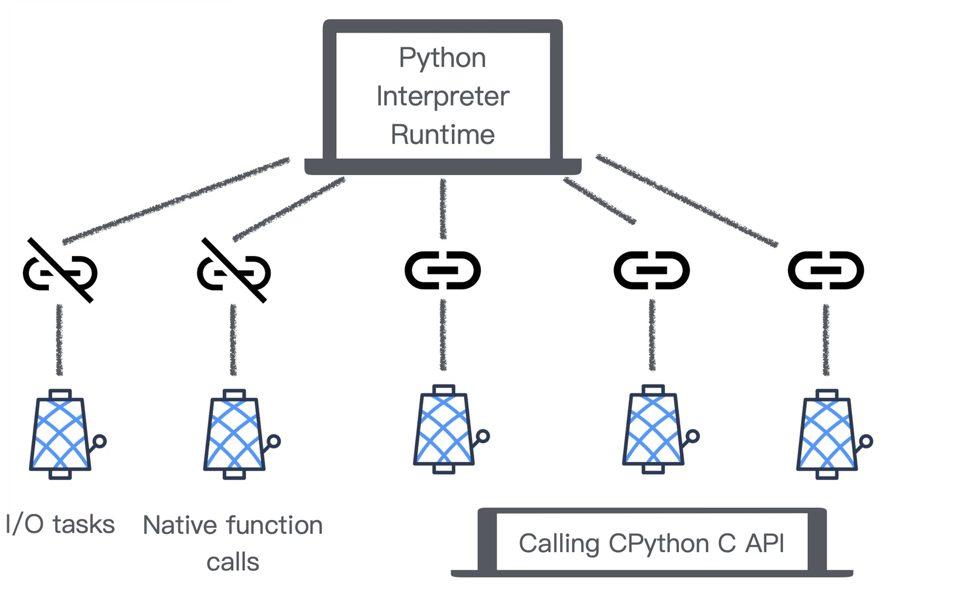

One ruler: does the work need the interpreter?
The packages we rely on for speed are native extensions: NumPy in C, pydantic-core and Polars in Rust.
The ruler applies right at the boundary where they meet Python.
Attached: the thread can touch Python objects and call Python code.
PyO3
• GIL on: only one attached thread at a time.
0.26: with_gil → attach,
• GIL off: as many as you want.
allow_threads → detach
0.28: free-thread-safe by default
Detached: the thread runs pure native code and promises not to touch Python.
0.29: abi3t
Touching Python objects requires an attached thread. Pure native work runs detached. That is the whole rule.
Diagrams adapted from py-free-threading.github.io/porting-extensions

Slide 43
The experiment
To measure this fairly, we need a native package we fully control. So I built a small Rust extension with PyO3.
100 red envelopes. Two types of workloads. Four ways to run them.
Arithmetic workload
Callback workload
1,000,000 integer operations per envelope.
80,000 calls to a Python function per envelope.
1
Pure Python (1 thread): the baseline arithmetic loop.
2
Pure Python (8 threads): the same loop on ThreadPoolExecutor.
3
Rust Native (8 workers): read inputs, detach, crunch in Rayon; never touches Python again.
4
Rust
Callback
(8
workers):
stay
attached,
each
calling
a
Python
light_scorer(amount, k)
80,000
times.
Note:
light_scorer()
is
a
pure
Python
function
with
no
shared
state.
Keep
this
in
mind
for
later.
github.com/xavierforge/red_envelope_demo (tag pycon-tw-2026-r2)

Slide 44

Does native Rust get even faster with the GIL off?
Rows 1–2 · from the opening
Workload | GIL on | GIL off | Speedup
Arithmetic · Pure Python (1 thread) | 18.938 s | 19.111 s | baseline
Arithmetic · Pure Python (8 threads) | 19.057 s | 3.811 s | ≈ 5.0x
Arithmetic · Rust Native (8 workers) | 0.042 s | ? | ?
Read inputs, detach, crunch in Rayon; never touches Python again.

Slide 45
Where the real speedup lives
Workload | GIL on | GIL off | Speedup
Arithmetic · Pure Python (1 thread) | 18.938 s | 19.111 s | baseline
Arithmetic · Pure Python (8 threads) | 19.057 s | 3.811 s | ≈ 5.0x
Arithmetic · Rust Native (8 workers) | 0.042 s | 0.043 s | ≈ 1.0x
Native speed + 8-way parallelism were already available with the GIL on.
Arithmetic and Callback are different workloads! Compare speedups within the same row only.
Workload | GIL on | GIL off | Speedup
Callback · Rust calling Python (8 workers) | 2.096 s | ? | ?
Same
free-threaded
build
(3.14.6t),
toggled
via
-X gil=1/0
;
median
of
5
runs
on
Apple
M1
Pro.
Detached native work was already fast.
Source: results/compare_2026-10-11.txt

Slide 46

Where the real speedup lives
Workload | GIL on | GIL off | Speedup
Arithmetic · Pure Python (1 thread) | 18.938 s | 19.111 s | baseline
Arithmetic · Pure Python (8 threads) | 19.057 s | 3.811 s | ≈ 5.0x
Arithmetic · Rust Native (8 workers) | 0.042 s | 0.043 s | ≈ 1.0x
Native speed + 8-way parallelism were already available with the GIL on.
Arithmetic and Callback are different workloads! Compare speedups within the same row only.
Workload | GIL on | GIL off | Speedup
Callback · Rust calling Python (8 workers) | 2.096 s | 0.349 s | ≈ 6.0x
Same
free-threaded
build
(3.14.6t),
toggled
via
-X gil=1/0
;
median
of
5
runs
on
Apple
M1
Pro.
Free-threading speeds up work that must stay attached. Detached native work was already fast.
Source: results/compare_2026-10-11.txt

Slide 47
Two checks before you expect a speedup
Check 1 · Can it even run free-threaded?
Check 2 · Which parts stay attached
to the interpreter?
• Must ship a free-threaded wheel and declare support (check py-free-threading.github.io).
Speeds up (Attached): threaded pure-Python loops, Python-level validation (Pydantic 2.11+), native libraries calling Python UDFs / callbacks / hooks.
• Python 3.14t requires a
cp314t
wheel.
•
Python
3.15+
introduces
abi3t
(stable
ABI):
one
wheel
covers
3.15+
(both
GIL
and
free-threaded).
Already fast (Detached): C/Rust number crunching that releases the GIL (NumPy-style).
Note:
Polars
has
shipped
neither
yet
(tracking
abi3t
in
issue
#27955).
A package only speeds up on its attached work, and only after it ships a compatible wheel.

Slide 48
The speedup lives right where the danger is
Attached parallelism means a package can now call your Python function from multiple threads at the exact same time.
from Act I
“Same code, same traps.
Rare bugs just became everyday bugs.”
Side 1
Rust's internal data
Side 2
Rust objects exposed to Python
Side 3
Your Python callback
Memory:
guarded by rustc
Memory:
guarded by PyO3
Memory:
guarded by CPython
Rust
Python
Who holds it?
owner · & · &mut
a mental reflex
Is it mutated?
mut · &mut ·
Mutex / Atomic
API encapsulation
Logic: on you
Logic: on you
Logic: on you
Across threads
Send · Sync
a shared vocabulary
At the Python boundary
The door that speeds up your callbacks also runs them in parallel. Act I's traps walk right back in.

Slide 49
Side 1: the compiler refuses what Python ran silently
Rust · src/main.rs, lines 7–12
from Act I
“
self.value += 1
across
8
threads,
let mut valid_count: u64 = 0;
GIL
off:
78–83%
of
updates
lost”
amounts.par_iter().for_each(|&amount| {
Rayon
runs
this
closure
across
multiple
threads
at
once,
so
it
only
allows
if amount % 2 == 0 {
shared
borrows
(
&
).
But
+=
requires
an
exclusive
borrow
(
&mut
).
valid_count += 1;
}
Aliasing XOR Mutability, caught at compile time.
});
Rust · cargo check
error[E0594]: cannot assign to `valid_count`, as it is a captured variable in a `Fn` closure
--> src/main.rs:10:13
|
7 | let mut valid_count: u64 = 0;
| --------------- `valid_count` declared here, outside the closure
8 | amounts.par_iter().for_each(|&amount| {
| --------- in this closure
9 | if amount % 2 == 0 {
10 | valid_count += 1;
| ^^^^^^^^^^^^^^^^ cannot assign
The compiler rejected the exact counter that Python ran silently. Memory layer, guarded by rustc.
Source: experiments/compile_fail/src/main.rs · results/compile_fail_E0594.txt

Slide 50
Side 1: fixing the counter in Rust
Rust
from Act II
“Don't share · Freeze · Lock”
// 1. Don't share: count per worker, then merge
let valid_count = amounts.par_iter()
Python:
the
standard
library
has
no
AtomicInt
.filter(|&&amount| amount % 2 == 0)
with
fetch_add
,
leaving
you
two
roads:
.count() as u64;
accumulate
per
task,
or
use
a
Lock.
// 2. Lock: wrap it in a Mutex
let valid_count = Mutex::new(0u64);
amounts.par_iter().for_each(|&amount| {
if amount % 2 == 0 {
*valid_count.lock().unwrap() += 1;
}
});
// 3. Atomic: a synchronized container, no lock
let valid_count = AtomicU64::new(0);
amounts.par_iter().for_each(|&amount| {
AtomicU64
is
lock-free,
but
8
threads
if amount % 2 == 0 {
hammering
one
atomic
still
contend
on
the
cache
valid_count.fetch_add(1, Ordering::Relaxed); // takes &self
line.
Per-task
counting
and
merging
is
the
}
});
low-contention
choice.
Three fixes following the exact same roads. (Freezing is out, since counters must change.)
Source: adapted from src/lib.rs (the three variants at the end of the file)

Slide 51
Side 2: PyO3 asks the questions at the boundary
1.
#[pyclass]
must
be
Sync
(since
PyO3
0.23):
the
Sync
gate,
enforced
right
at
the
Python
boundary.
2.
Concurrent
calls
to
a
&mut self
method
raise
RuntimeError: Already borrowed
.
Aliasing
XOR
Mutability,
enforced
at
runtime.
3.
py.detach(|| ...)
requires
Ungil:
nothing
tied
to
the
interpreter
is
allowed
to
sneak
out.
Rust
Python
Probe: 8 Python threads calling
bump_mut()
on one object.
Who holds it?
owner · & · &mut
a mental reflex
GIL off:
1
succeeded,
7
raised
Already borrowed
Is it mutated?
mut · &mut ·
Mutex / Atomic
API encapsulation
GIL on: all 8 succeeded (serialized by the GIL).
Across threads
Send · Sync
a shared vocabulary
Recommended
pattern:
#[pyclass(frozen)]
wrapping
a
synchronized
container
(“thread-safe
by
construction”).
Verified
with
pytest-run-parallel.
At the Python boundary
Sync required · runtime borrow check · Ungil
PyO3 asks both questions for every object exposed to Python. Memory layer, guarded by PyO3.
Source: results/borrow_checker_probe_2026-10-11.txt

Slide 52
Side 3: your callback, and who guards which half
Side 3 · Your Python callback: memory is guarded by CPython (per-object locks), but logic is guarded by nobody.
C Extension Authors
PyO3 (Rust) Authors
You (Python Developers)
Must
audit
by
hand.
Replace
borrowed
The type system and runtime borrow checker handle most of the memory audit for you (Side 2).
Guard the shared state inside your callbacks, using the three questions and API encapsulation.
refs
with
PyList_GetItemRef
;
remember
Py_mod_gil_not_used
is
just
a
promise,
not
a
compiler
check.
from Act I
“Supports free-threading” is not “thread-safe”.
When a package declares free-threading support, it means it finished its half of the job, under its documented rules.
Every side has a guardian for memory: rustc, PyO3, CPython. None has one for logic. That half is yours.

Slide 53
Who else holds this?
Is anyone changing it?
Act I
Python never required the two questions, so we stopped asking.
Act II
Rust's type system asks them for every value, and we brought that mindset home.
Act III
Across the boundary: rustc, PyO3, and CPython guard memory. Logic is on you.
Free-threaded builds open the door to parallelism,
but they don't protect you once you walk through it.

Slide 54
Defaults worth borrowing
from Act II
“Not
shared
unless
wrapped
in
Arc<Mutex<T>>
·
Immutable
unless
declared
mut
·
The
lock
owns
the
data”
1
Shared data: make it immutable by default.
2
Mutable data: bind it to its lock, and expose only complete operations.
3
Crossing threads: hand ownership over, then let go.
Python
3.15
adds
frozendict
(PEP
814):
a
good
fit
for
shared
read-only
state.
Still
a
shallow
freeze,
like
the
rest.
Now that the stable ABI has landed,
what should Python's concurrency defaults look like?
Rust gets these defaults from its compiler. In Python, we build them into our own APIs.

Slide 55
Start today with just one object
from Act I
“Thread safety isn't my problem. Python handles it.”
1
Pick one shared cache, counter, or Session in your codebase.
2
Ask: Who else holds this? Is anyone changing it?
3
If both: give each thread a copy, freeze it, or wrap the whole operation in one method.
Upgrade
Wait
Build
The
3.15
macOS
installer
ships
python3.15t
by
Let the tracking table and wheel availability guide your timeline.
Rewrite your own hotspots
in Rust with PyO3.
default
(GIL
off
by
default).
Run
the
two
checks
on
your
dependencies
first.
Start with one object today. Whether you upgrade tomorrow depends on your packages, not on this talk.
See the repo README for a complete 6-question checklist.

Slide 56

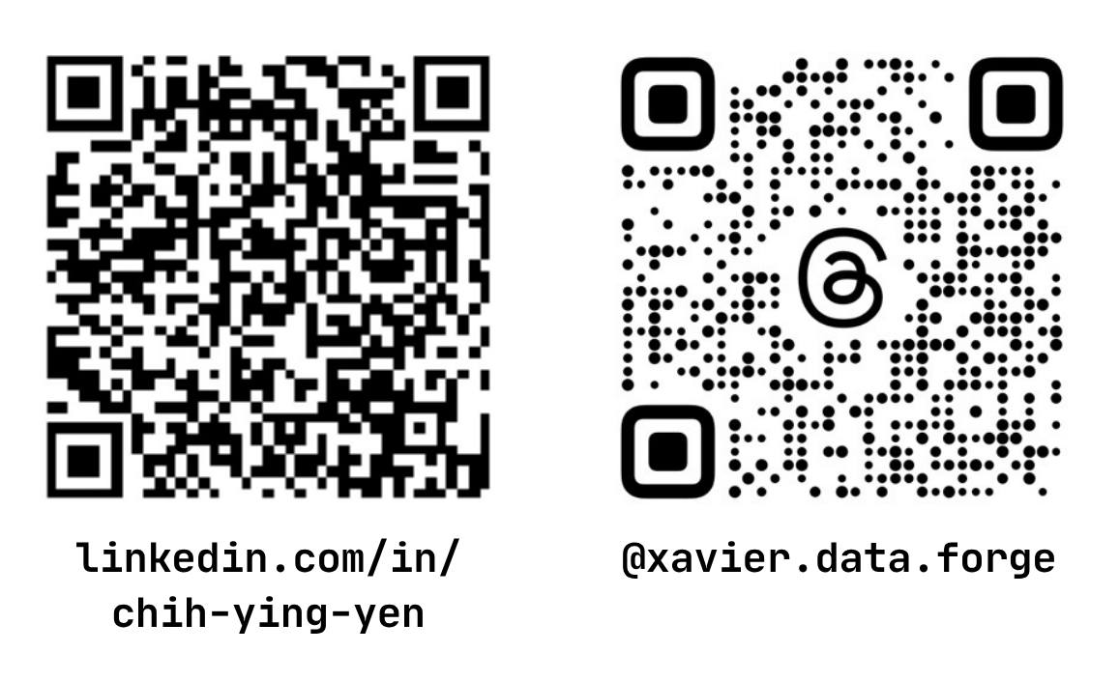
Thank you
Repo: github.com/xavierforge/red_envelope_demo
Book: From Pythonista to Rustacean (深智數位, 2026)
xavierforge.dev

Slide 57
The GIL in 20 seconds
Backup · B1
The GIL (global interpreter lock) lets only one thread in a process execute Python bytecode at a time.
The free-threaded build removes it; per-object locks keep the interpreter's own structures safe.

Slide 58
PyO3 version trail
Backup · B2
Version | Change
0.23 | #[pyclass] requires Sync
0.26 | with_gil / allow_threads renamed to attach / detach
0.28 | declares free-thread-safe by default
0.29 | abi3t

Slide 59
PEP 788 (Final, 3.15)
Backup · B3
PyGILState_* is soft-deprecated in favor of PyThreadState APIs.
It also addresses finalization.

Slide 60
Data race, full definition
Backup · B4
1 Two or more threads access the same memory location concurrently.
2 At least one of the accesses is a write.
3 The accesses are not synchronized.
Synchronized means the accesses are ordered by something: a lock, an atomic operation, a channel send and receive, or a thread join.

Slide 61
PEP 703 pillars
Backup · B5
Biased RC
Immortal objects
Deferred RC
Per-object locks
mimalloc
Stop-the-world GC

Slide 62
Critical sections are not MutexGuards
Backup · B6
They can be released when the thread is about to block.

Slide 63
Why Mutex<T>: Sync needs only T: Send
Backup · B7
The mutex hands out one
&mut T
at a time.

Slide 64
cache_probe, the 1 µs column
Backup · B8
GIL on, 1 µs
425–435
Higher than GIL off.
Time-slicing stretches every compute window across all 8 threads.
duplicates

Slide 65
Why 5x on 8 threads
Backup · B9
Apple M1 Pro: 6 performance + 2 efficiency cores.

